Slide 1
Wiggles, Walks, and Wild Wandering Electrons
By Mac

Slide 2
Demonstration
Monte Carlo
Notes:
https://upload.wikimedia.org/wikipedia/commons/c/cb/Random_walk_25000.svg

Slide 3
But Why Aren’t They Equal?
BINOMIAL DISTRIBUTION
Odd are 50-50, so you either get heads or you don’t
But not necessarily HTHTHTHTHTHTHTHTHTHTHTHTHTHTHTHTHTHTHTHTHTHTHTHTHTHTHTHTHTHTHTHTHTHTHTHTHTHTHTHTHTHTHTHTHTHTHTHTHTHTHTHTHTHTHTHT…

Slide 4
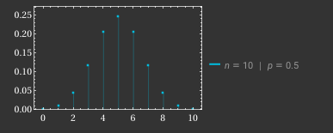
X~Bin(10,5)

Slide 5
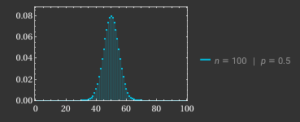
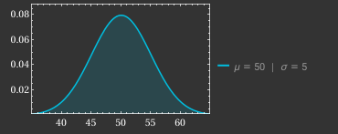
X~Bin(100,0.5) X~N(50,5^2)
≅

Slide 6



Using the binomial distribution
Define random variables s_{i} being either +1 or -1 at 50% probability
Let N be the number of steps, N₊ be the number of +1s, N₋ be the number of -1s
Displacement: D = |N₊ - N₋ | = |2N₊ - N|
Mean displacement is expected value: ⟨|D|⟩=E(|2nr−N|)
P(N₊ = k) N₊ ~Bin(N, 50%)
Assuming N is even: ⟨|D|⟩=∑^{N}_{k=0} P(N₊ = k) |2k−N|
Even
General

Slide 7



Using the Normal Distribution
Mean: ⟨R⟩ = ⟨s₁ + ⋯ + s_{N}⟩ = N⋅0 = 0
Variance: Var(R) = Var(s₁ + ⋯ + s_{N}) = N⋅Var(s_{i}) = N 𝜎 = √Var(R) = √N
R~Normal(0,N) PDF
⟨|R|⟩ = ∫∞_{-∞} |r|⋅f(r) dr ⇒ ⟨|R|⟩ = 2∫∞₀ |r|⋅f(r) dr ⇒

Slide 8
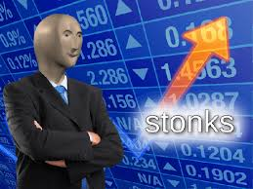
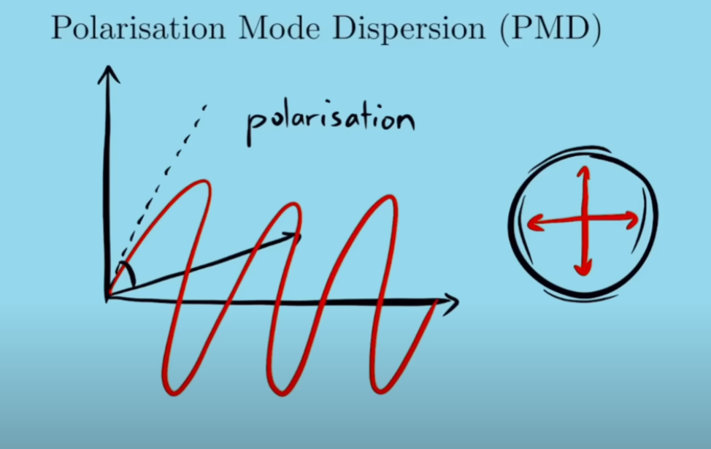
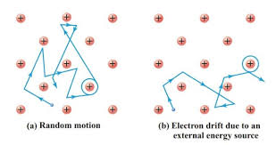
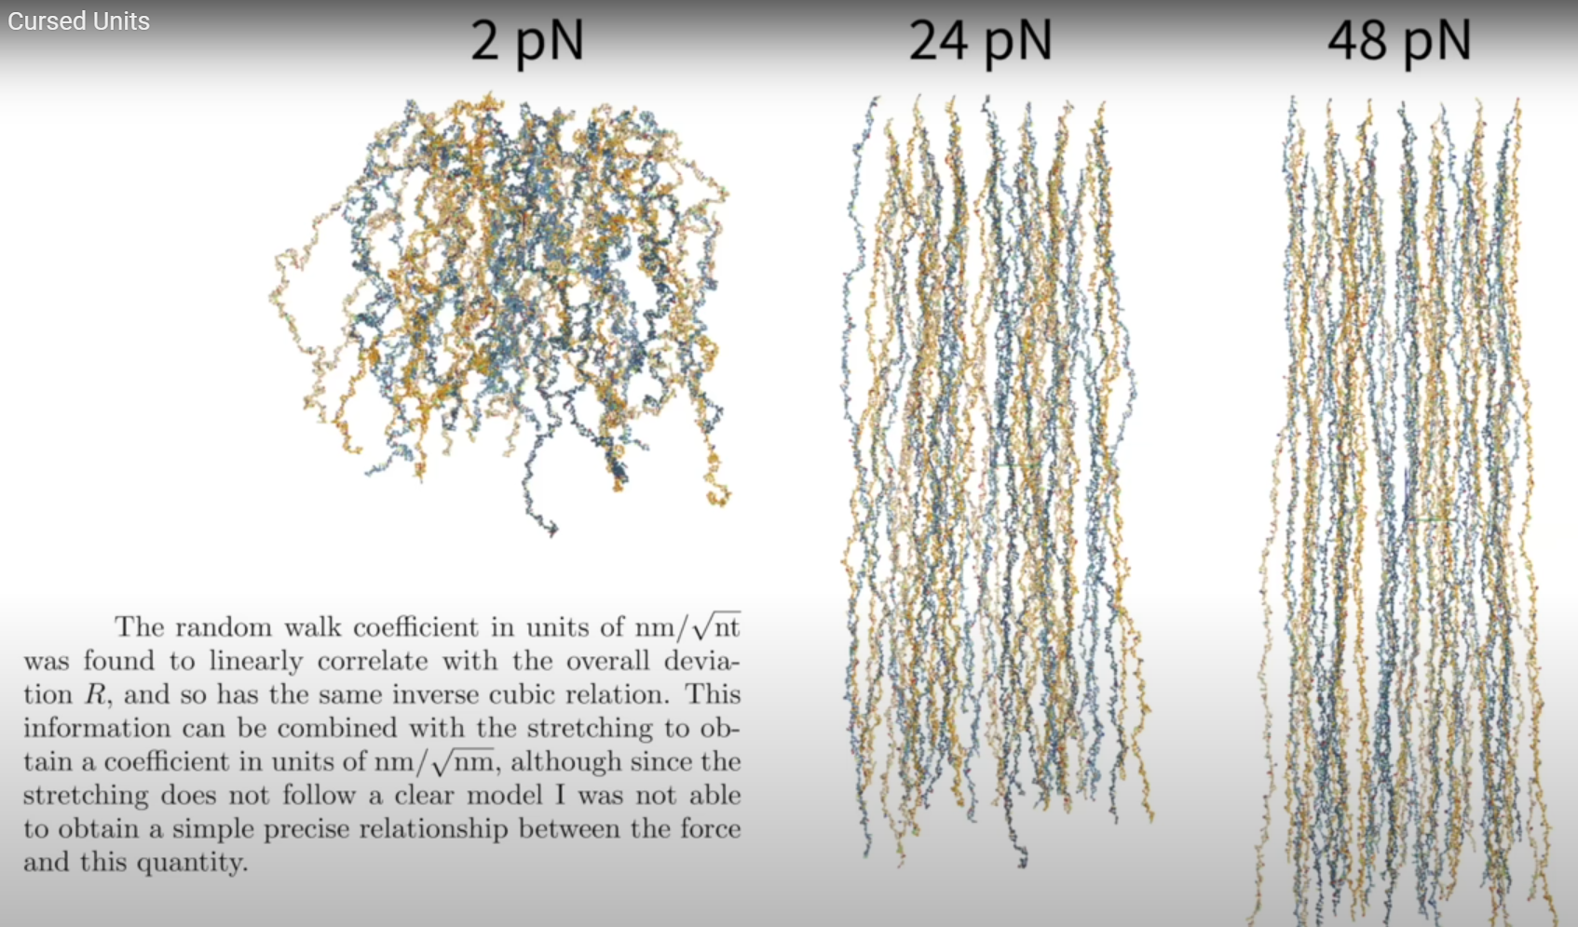
But where is this used?
Brownian Motion

Slide 9
THANKS FOR LISTENING MERCI DE VOTRE ÉCOUTE GRACIAS POR ESCUCHAR
सुनने के लिए धन्यवाद
DANKE FÜRS ZUHÖREN
感謝您的聆聽
ご清聴ありがとうございました
DZIĘKI ZA SŁUCHANIE
들어주셔서 감사합니다
MULȚUMESC PENTRU ASCULTARE
شكرا على الاستماع
СПАСИБО ЗА СЛУШАНИЕ

